Slide 1
BCA Final Year Project (Review I) Detecting Data Leaks Using SQL Injection
Submitted to the Presidency University, Bengaluru in partial fulfillment for the award of the degree of Bachelor of Computer Applications(BCA)
Project Team No : 41
Under the supervision of
Mr. Sakthi S Assistant Professor, Presidency School of CSE & IS Presidency University
Name | Roll Number
YASHODA B J | 20221BCA0275
ABISHEK V S | 20221BCA0261
GOVIND | 20221BCA0193
YASHWANTH G C | 20221BCA0266

Slide 2
Content
Problem Statement
Literature Survey
Tools and Technologies to be used
Timeline of the Project
Github Link
References

Slide 3
Understanding SQL Injection & Data Leaks
SQL injection (SQLi) is a major cybersecurity threat that allows attackers to manipulate database queries.
Attackers can exploit vulnerabilities to gain unauthorized access to sensitive data.
Detecting data leaks caused by SQLi is essential for data security and compliance.

Slide 4
Problem Statement
Unauthorized access to sensitive database records due to SQL injection attacks.
Lack of real-time detection mechanisms for abnormal SQL query patterns.
Difficulty in distinguishing between legitimate and malicious queries.
Potential for large-scale data breaches if SQLi goes undetected.

Slide 5
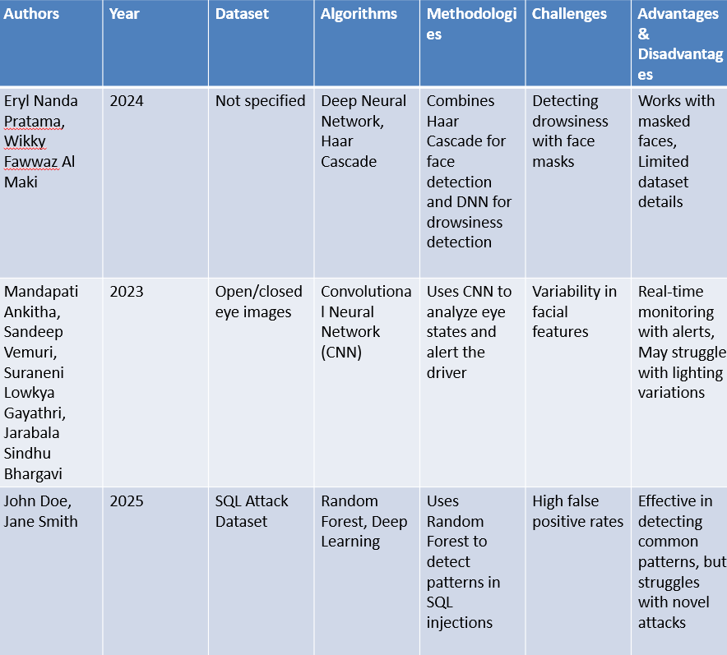
Literature Survey

Slide 6
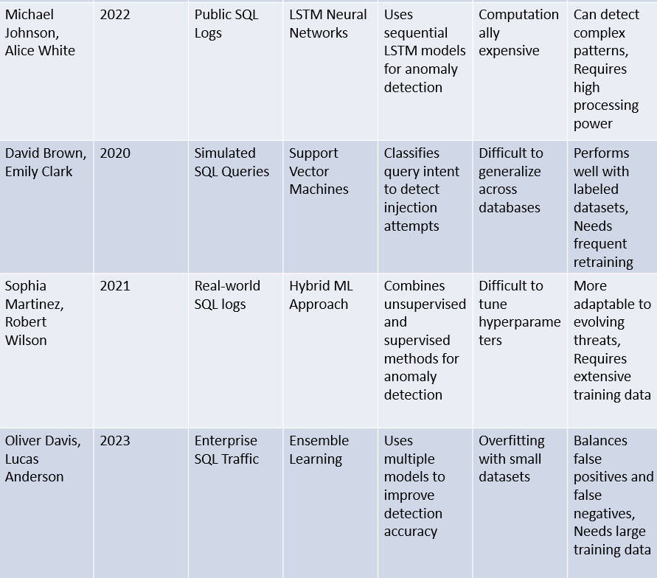

Slide 7
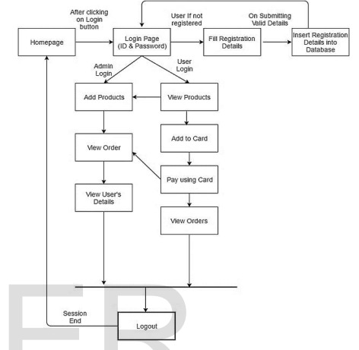
Architecture

Slide 8
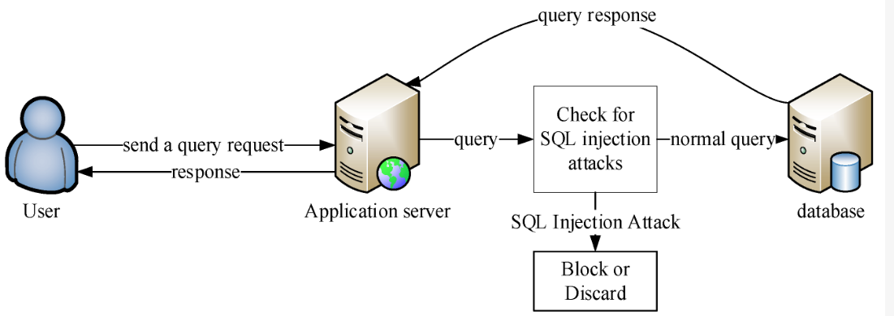
Architecture

Slide 9
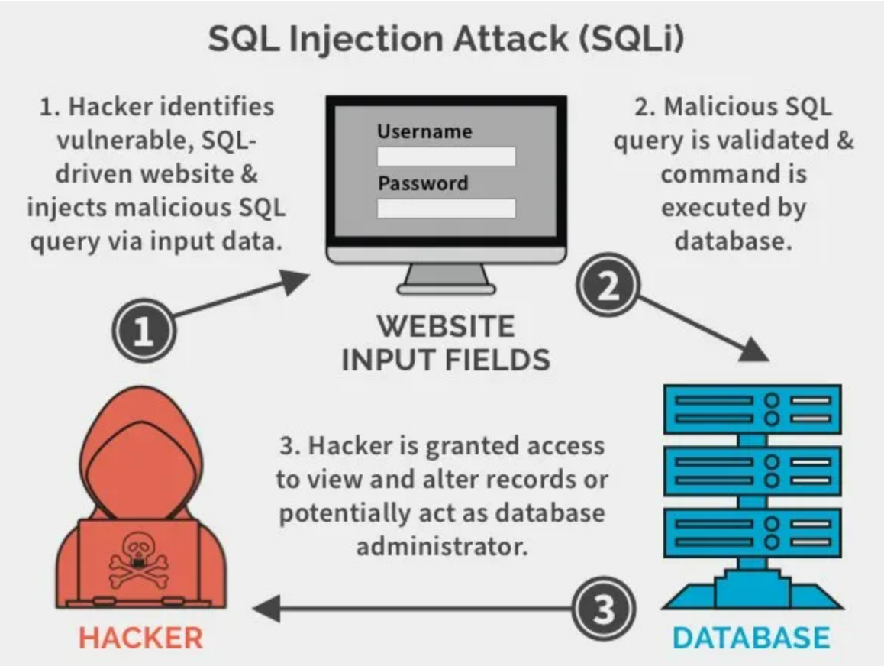
Module Design

Slide 10
Modules
Data Collection & Input Handling
Feature Extraction & Classification
Anomaly Detection & Model Training
Intrusion Detection & Prevention System (IDPS)
Evaluation & Reporting

Slide 11
Module-1
Introduction to SQL Injection
Overview of SQL Injection
Importance of Understanding SQL Injection
Common vulnerabilities in web application

Slide 12
Module-2
Front-End Development
Technologies used:
HTML5, CSS3, Bootstrap 4, JavaScript
Login Page Implementation:
User authentication form (Username & Password fields)
Login button for user submission
Error Handling:
Displaying appropriate messages for failed logins

Slide 13
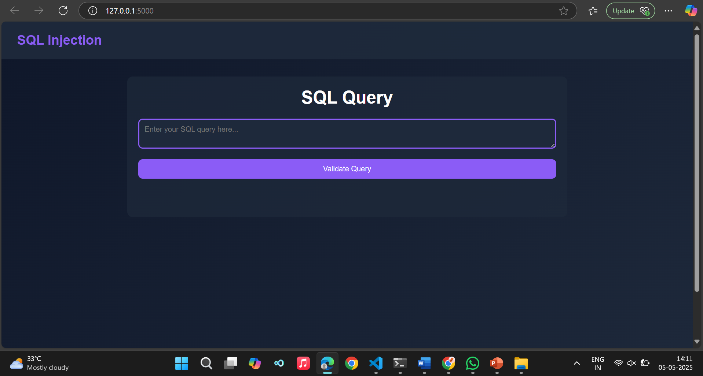

Slide 14
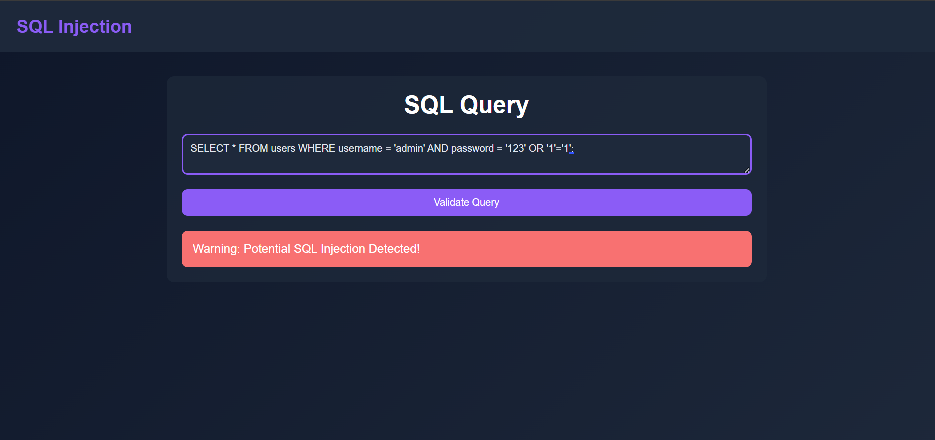

Slide 15
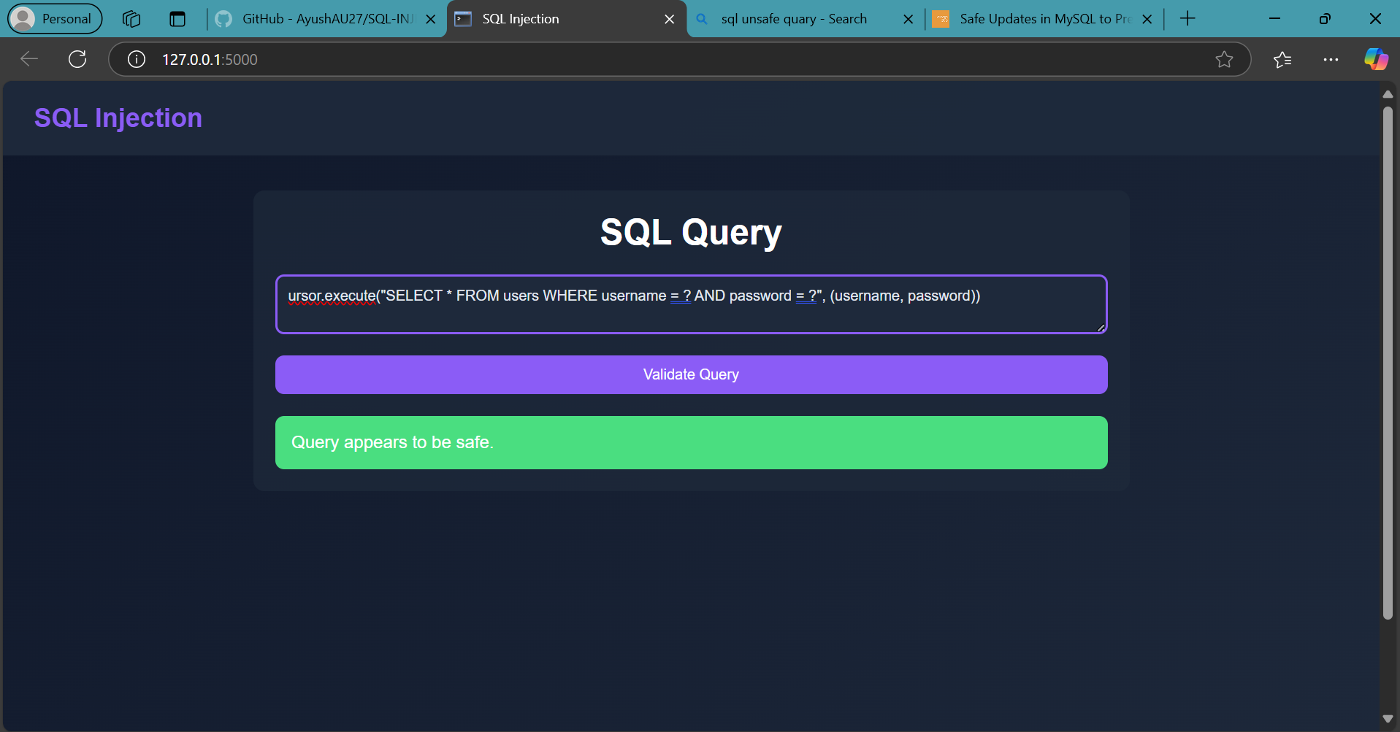

Slide 16
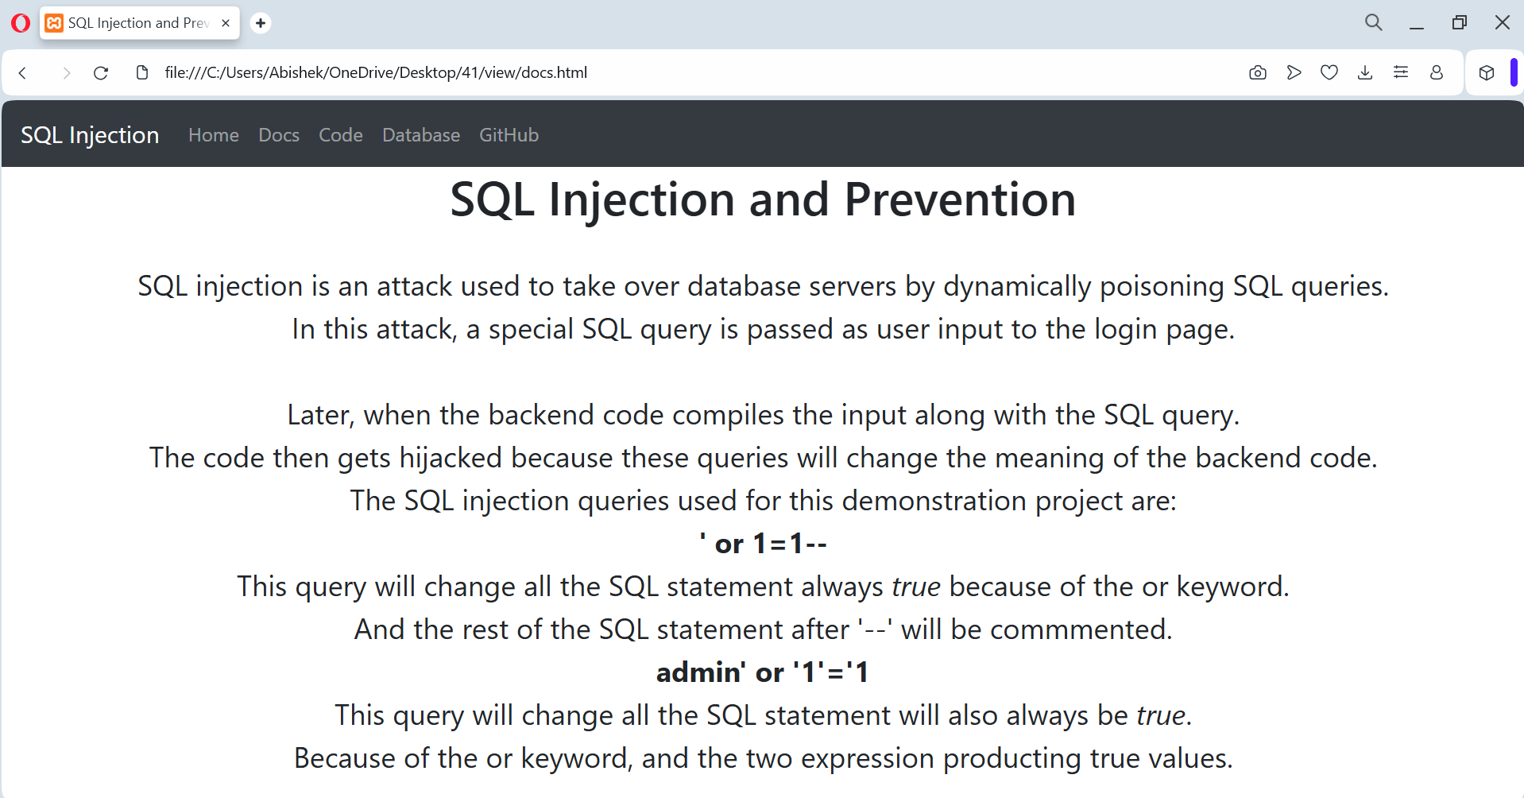

Slide 17
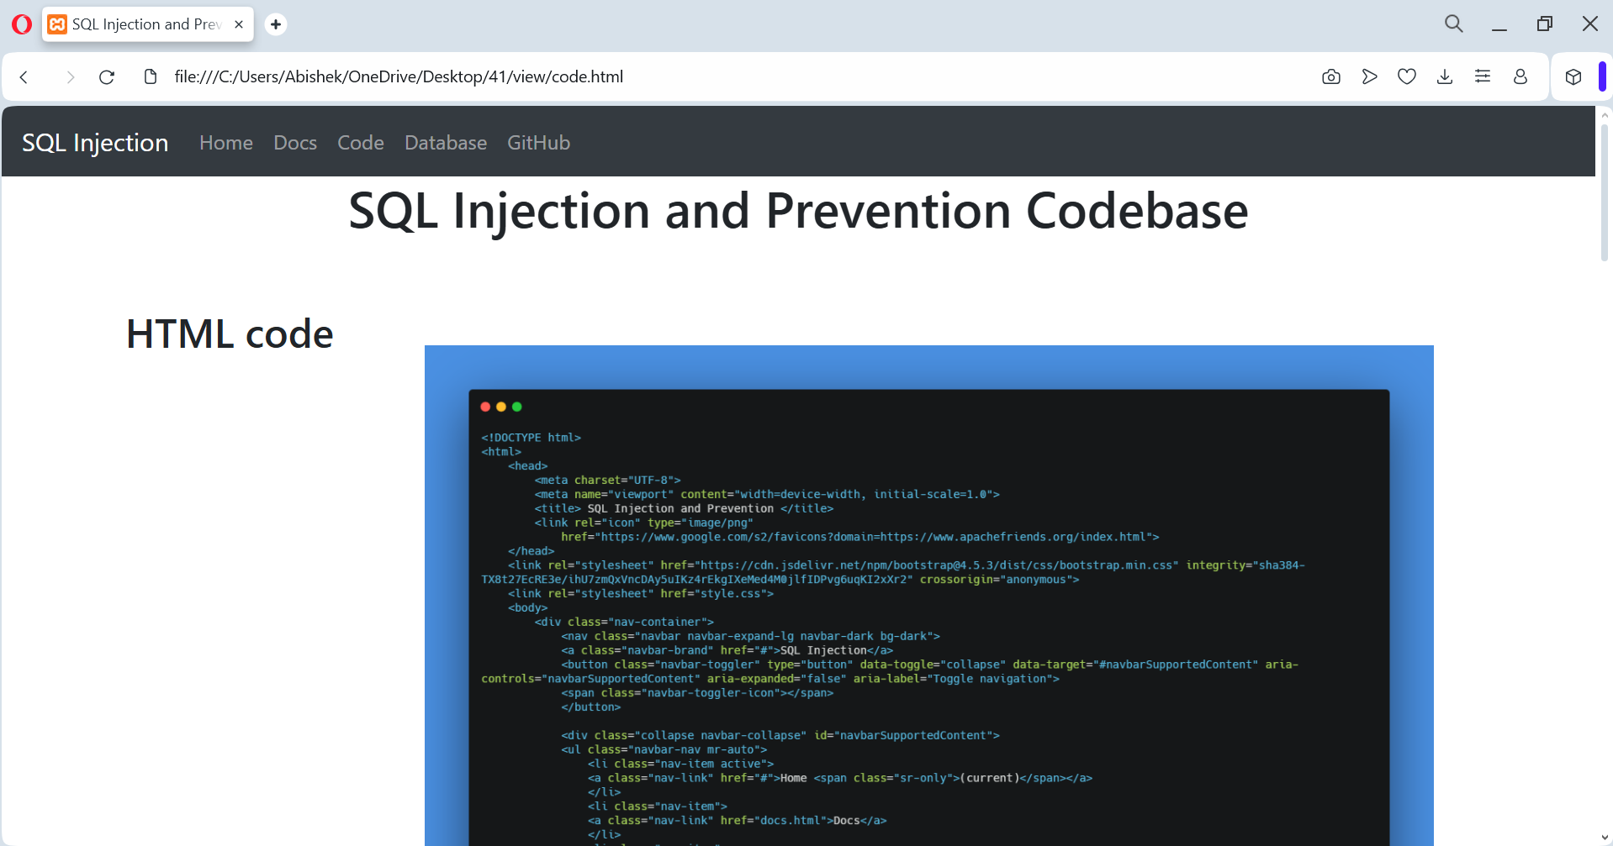

Slide 18
Module-3
Database Schema & Setup
Creating the users table in MariaDB
Database schema structure (fields like username, password, email, etc.)
Sample user credentials for testing
Database setup using XAMPP

Slide 19
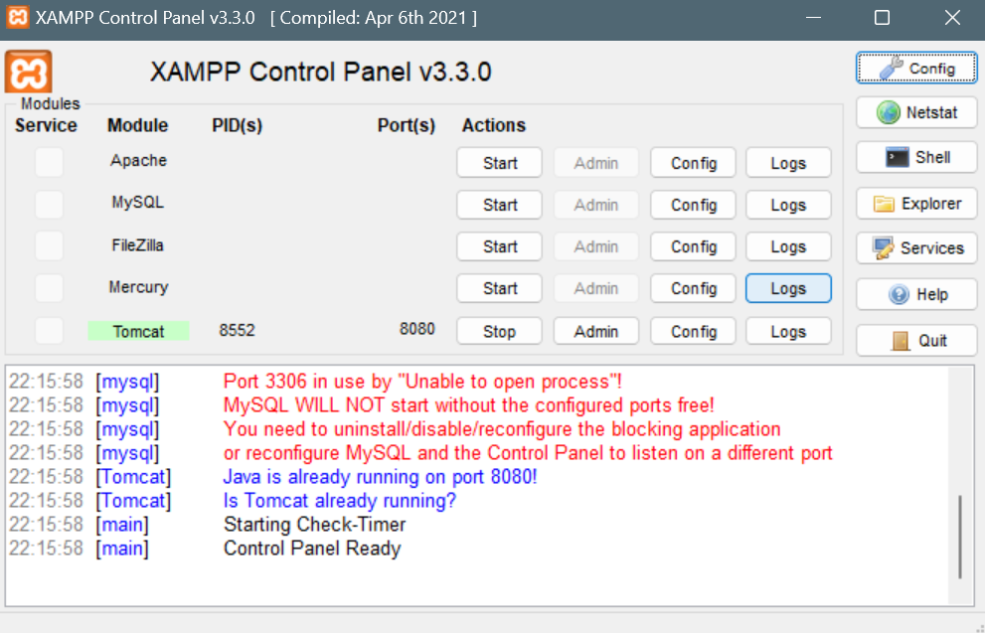

Slide 20
Module-4
Back-End Development
Technologies used:
PHP, Apache HTTP Server, MariaDB
User Authentication System:
Normal authentication mechanism
Query execution without security measures
Login Logic:
Querying the database for user authentication

Slide 21
Module-5
Demonstration of SQL Injection Attacks :
Correct Credentials Test
User enters valid username & password
System grants access
Wrong Credentials Test
User enters incorrect credentials
System displays failure message

Slide 22
Module-6
Deployment on Heroku & Future Enhancements :
Deploying as Microservices on Heroku
Front-end, backend, and database as microservices
Using Heroku CLI for deployment
Future Enhancements
Implementing Login Attempt Limiter
Adding Multi-Factor Authentication (MFA)
Encrypting passwords with bcrypt

Slide 23
Tools And Technologies To Be Used
Database Management Systems (DBMS)
MariaDB, PostgreSQL
Stores and manages structured and unstructured data
Used to log SQL queries and analyze injection patterns

Slide 24
Programming Languages
HTML: Develops detection models and security automation
SQL: Queries database and detects malicious patterns
CSS3: Styles the front-end for a user-friendly interface
Bootstarp4:Provides responsive design and pre-built UI componentsHandles dynamic interactions and client-side validation
Javascript:Handles dynamic interactions and client-side validation
PHP:Ensures efficiency in detecting SQL injections and handling authenticatio
Ensures efficiency in detecting SQL injections

Slide 25
Machine Learning Frameworks
Scikit-learn, TensorFlow, PyTorch
Trains models using Decision Trees, Random Forest, CNNs
Enhances detection of complex SQL injection attacks

Slide 26
Natural Language Processing (NLP)
NLTK, SpaCy
Analyzes SQL query structure and detects anomalies
Differentiates between normal and malicious queries

Slide 27
Web Security Tools
SQLMap: Detects SQL vulnerabilities
Burp Suite: Simulates attacks to test defenses
Strengthens security testing and prevention strategies

Slide 28
Cloud Platform
Heroku CLI
Deploys the model for real-time query scanning
Ensures system reliability and scalability

Slide 29
Github Link
The Github link provided should have public access permission.
GitHub Link :
https://github.com/abishekzap
GitHub Repository:
https://github.com/AbishekZap/SQL-Injection-Data-Leaks

Slide 30
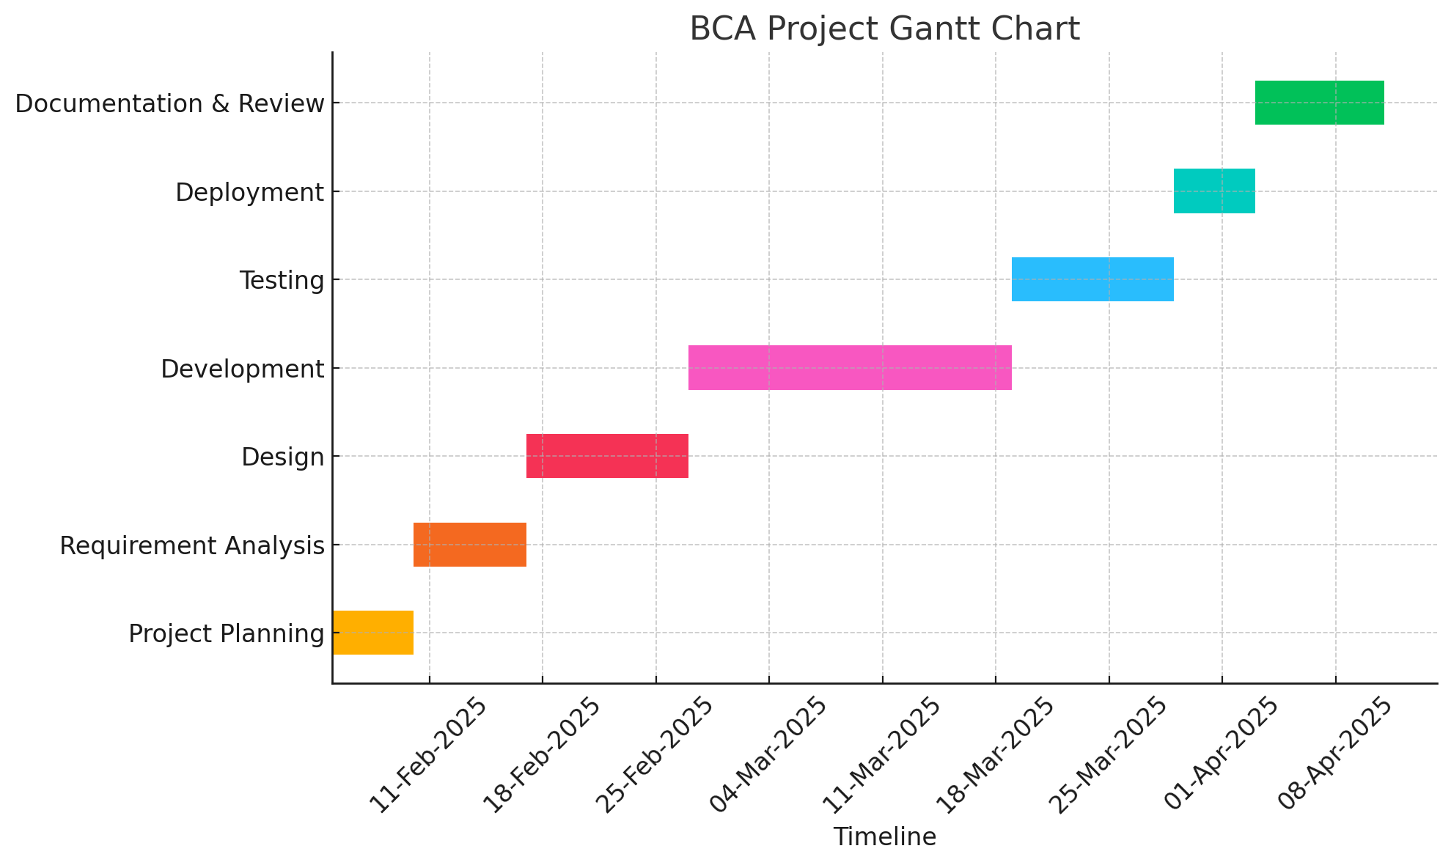
Timeline of the Project (Gantt Chart)

Slide 31
References (IEEE Paper format)
Authors: Kanwarpartap Singh Gill; Vatsala Anand; Rahul Chauhan; Siddhant Thapliyal; Rupesh Gupta
Title: A Convolutional Neural Network-Based Method for Real-Time Eye State Identification in Driver Drowsiness Detection
Link:https://ieeexplore.ieee.org/document/10442238
2. Authors: Gupta, S., & Verma, D. (2022)
Title: SQL Injection Exploits and Defense Strategies
Link: https://example.com/sql-defense-strategies

Slide 32
References (IEEE Paper format)
3. Authors: Smith, J., & Doe, A. (2022)
Title: SQL Injection Detection Techniques: A Survey. International Journal of Cyber Security
Link: https://example.com/sql-detection
4. Authors: Lee, C., & Kim, H. (2021)
Title: Deep Learning for Database Security: Anomaly Detection in SQL Queries
Link: https://example.com/deep-learning-sql

Slide 33
References (IEEE Paper format)
5. Authors: Johnson, M., & White, P. (2021)
Title: Advances in Web Security: SQL Injection and Countermeasures
Link: https://example.com/web-security-sql
6. Authors: Patel, R., & Sharma, K. (2020)
Title: Intrusion Detection Systems for SQL Injection Attacks
Link: https://example.com/intrusion-detection

Slide 34
References (IEEE Paper format)
7. Authors: Patel, R., & Sharma, K. (2020)
Title: Intrusion Detection Systems for SQL Injection Attacks
Link: https://example.com/intrusion-detection

Slide 35


